Slide 1


Slide 2
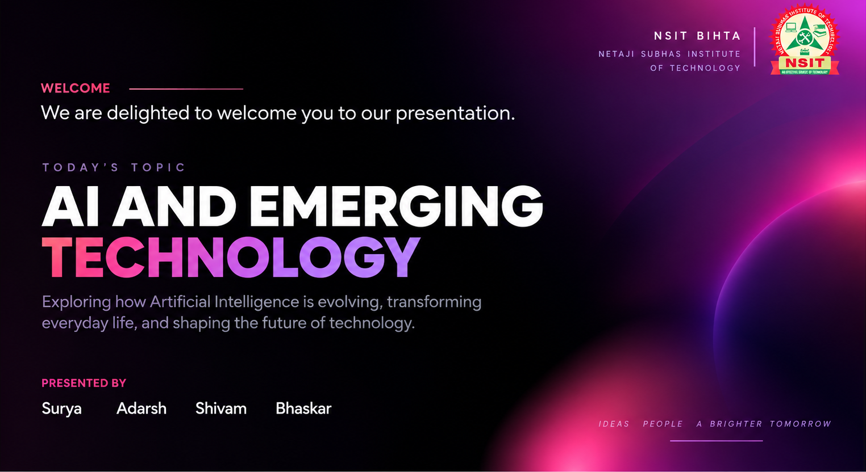

Slide 3
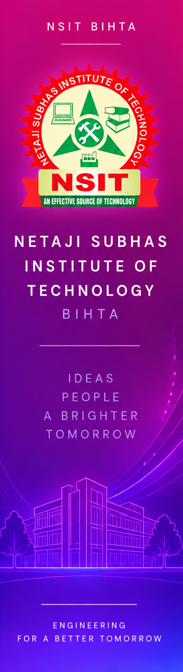
AGENDA
01
History
04
Impact & Challenges
02
Importance
05
Smarter Living with AI
03
Innovations
06
Conclusion

Slide 4
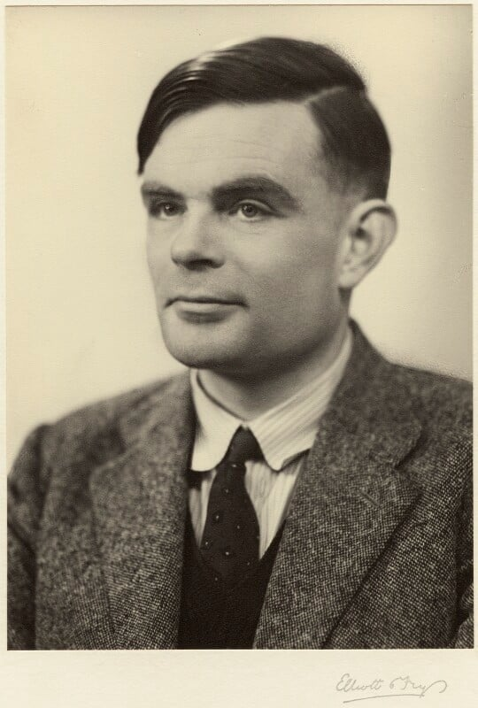
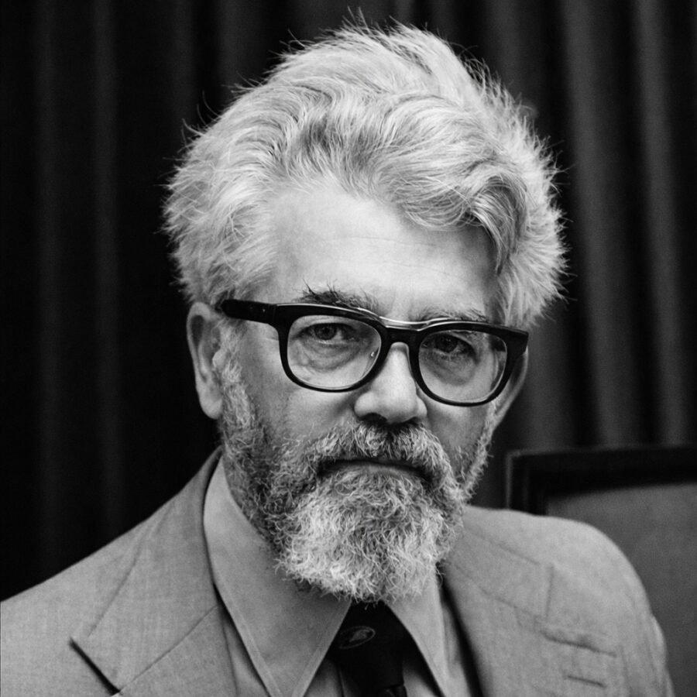
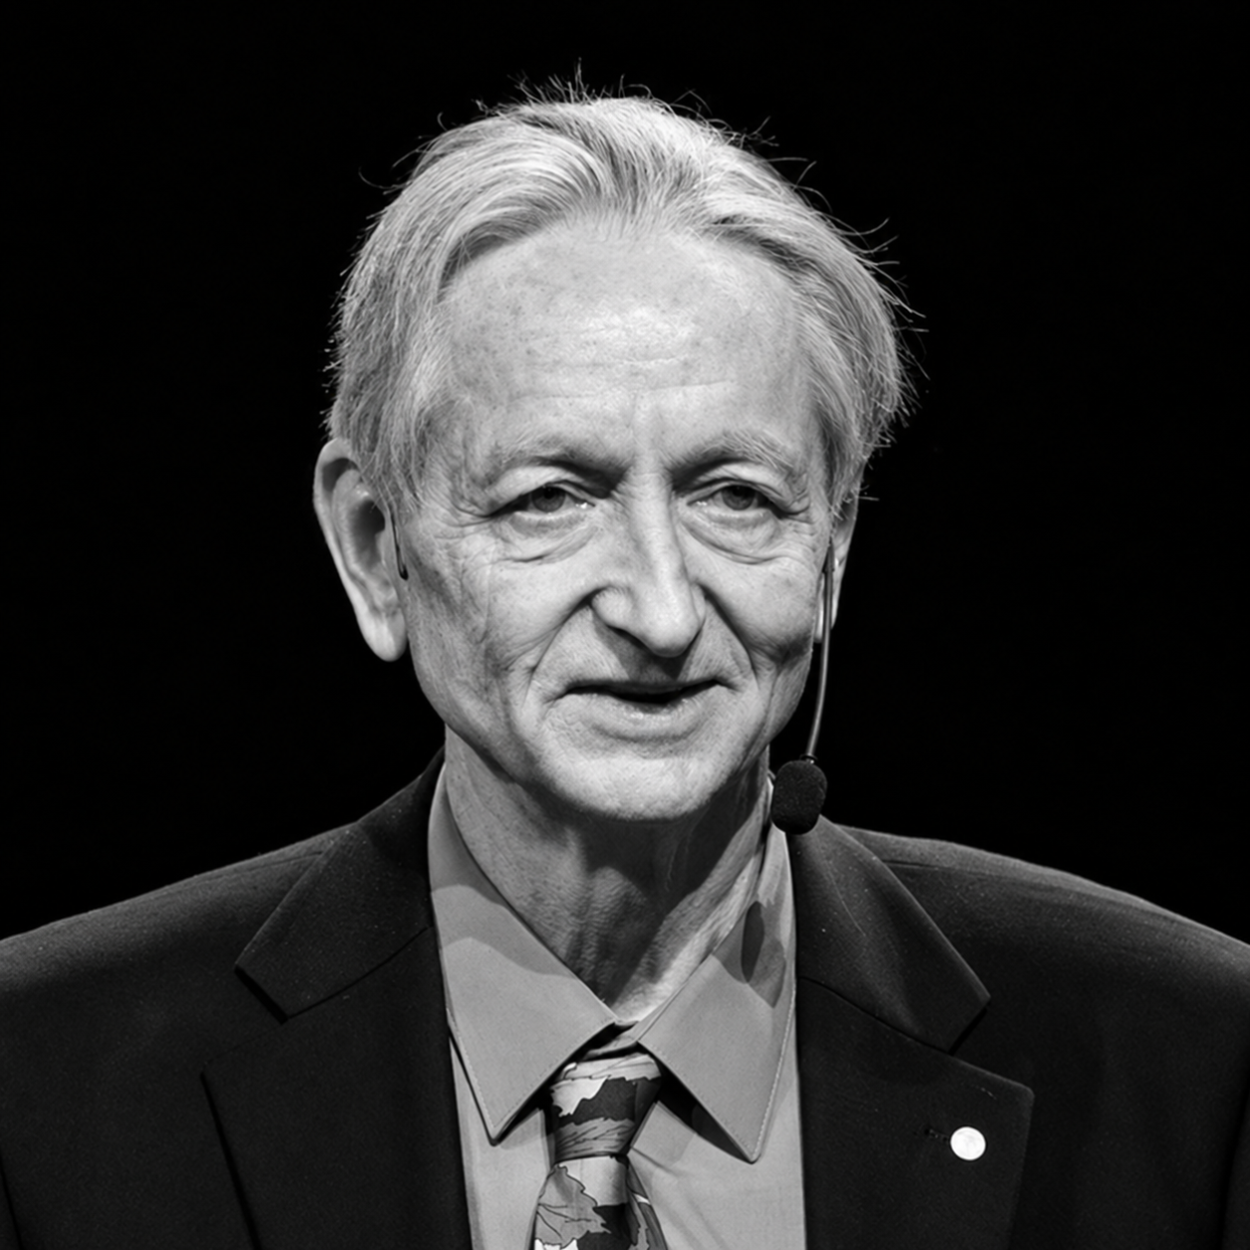
Alan Turing
John McCarthy
Geoffrey Hinton
Pioneer of Machine Intelligence
Father of Artificial Intelligence
Deep Learning Pioneer
Introduced the Turing Test, establishing foundational criteria for machine intelligence
Coined the term "Artificial Intelligence" in 1956, in Dartmouth Conference, and created LISP, the standard AI programming language.
Known as one of the "Godfathers of AI," his groundbreaking work on backpropagation and neural networks paved the way for modern generative AI models.

Slide 5




NSIT
01 — AUTOMATION
Eliminates repetitive work.
Benefits of AI
Why is AI Important?
AI is reshaping how we work, solve problems, and discover new opportunities
04 — DECISIONS
Supports faster, evidence-based decisions.
02 — DATA
Analyses massive datasets and reveals patterns.
05 — DISCOVERY
Accelerates science and innovation.
03 — PRODUCTIVITY
Speeds up everyday workflows.

Slide 6

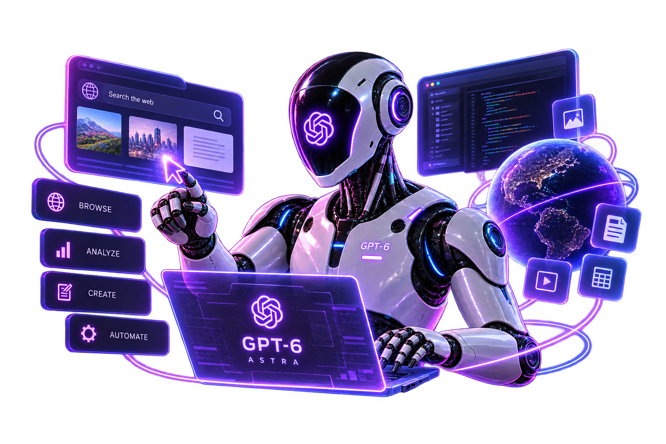
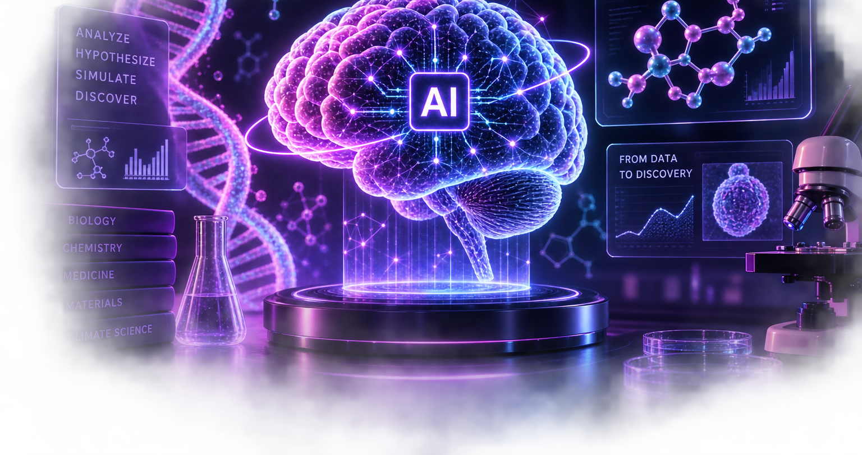
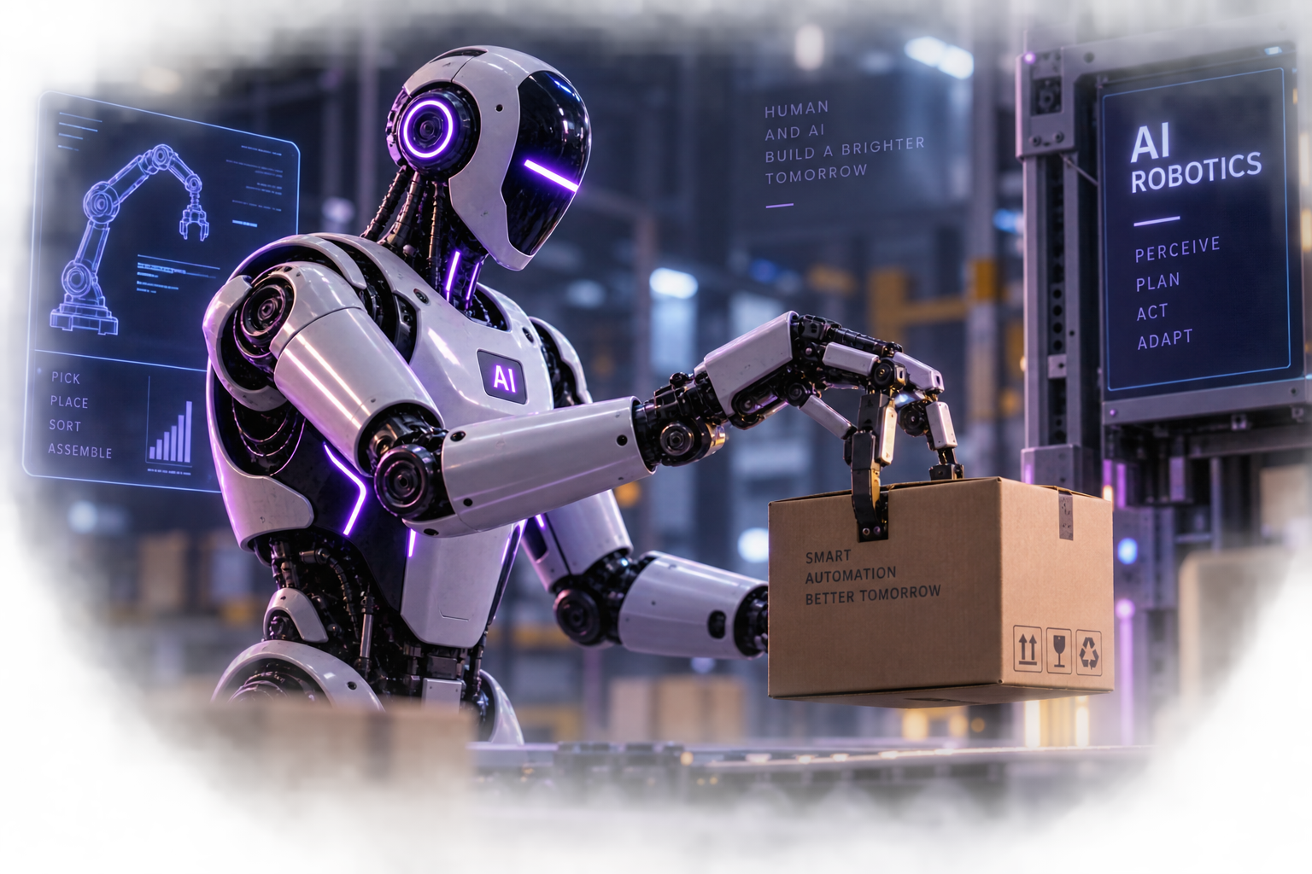
Latest Innovations in AI
01
02
03
GPT-6 Astra
Frontier AI & Computer Use
Advanced AI can reason, browse, use computers, write software, and execute complex multi-step workflows with less human intervention.
AI for Scientific Discovery
From prediction to hypothesis
AI is helping researchers generate hypotheses, design experiments, analyze biology, and accelerate scientific discovery.
AI Robotics
AI enters the physical world
Multimodal models are enabling robots to perceive environments, reason about tasks, and coordinate physical actions.
Key Frontier: AI is moving from answering questions → taking actions → discovering solutions.

Slide 7
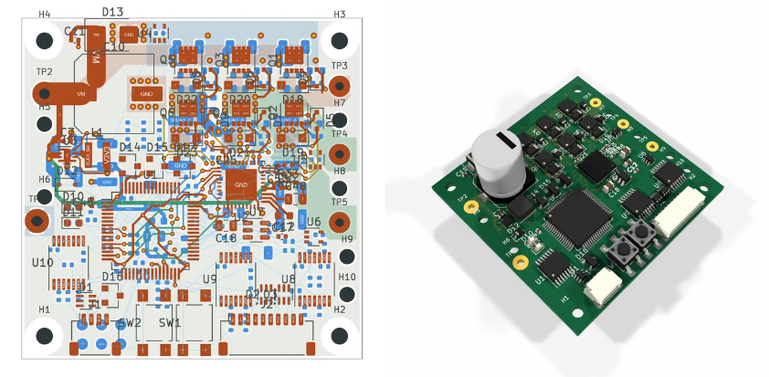
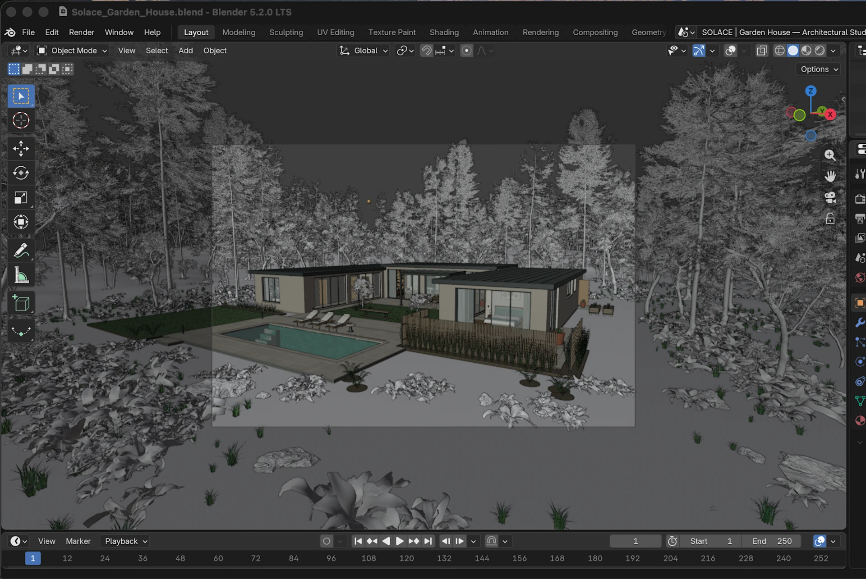
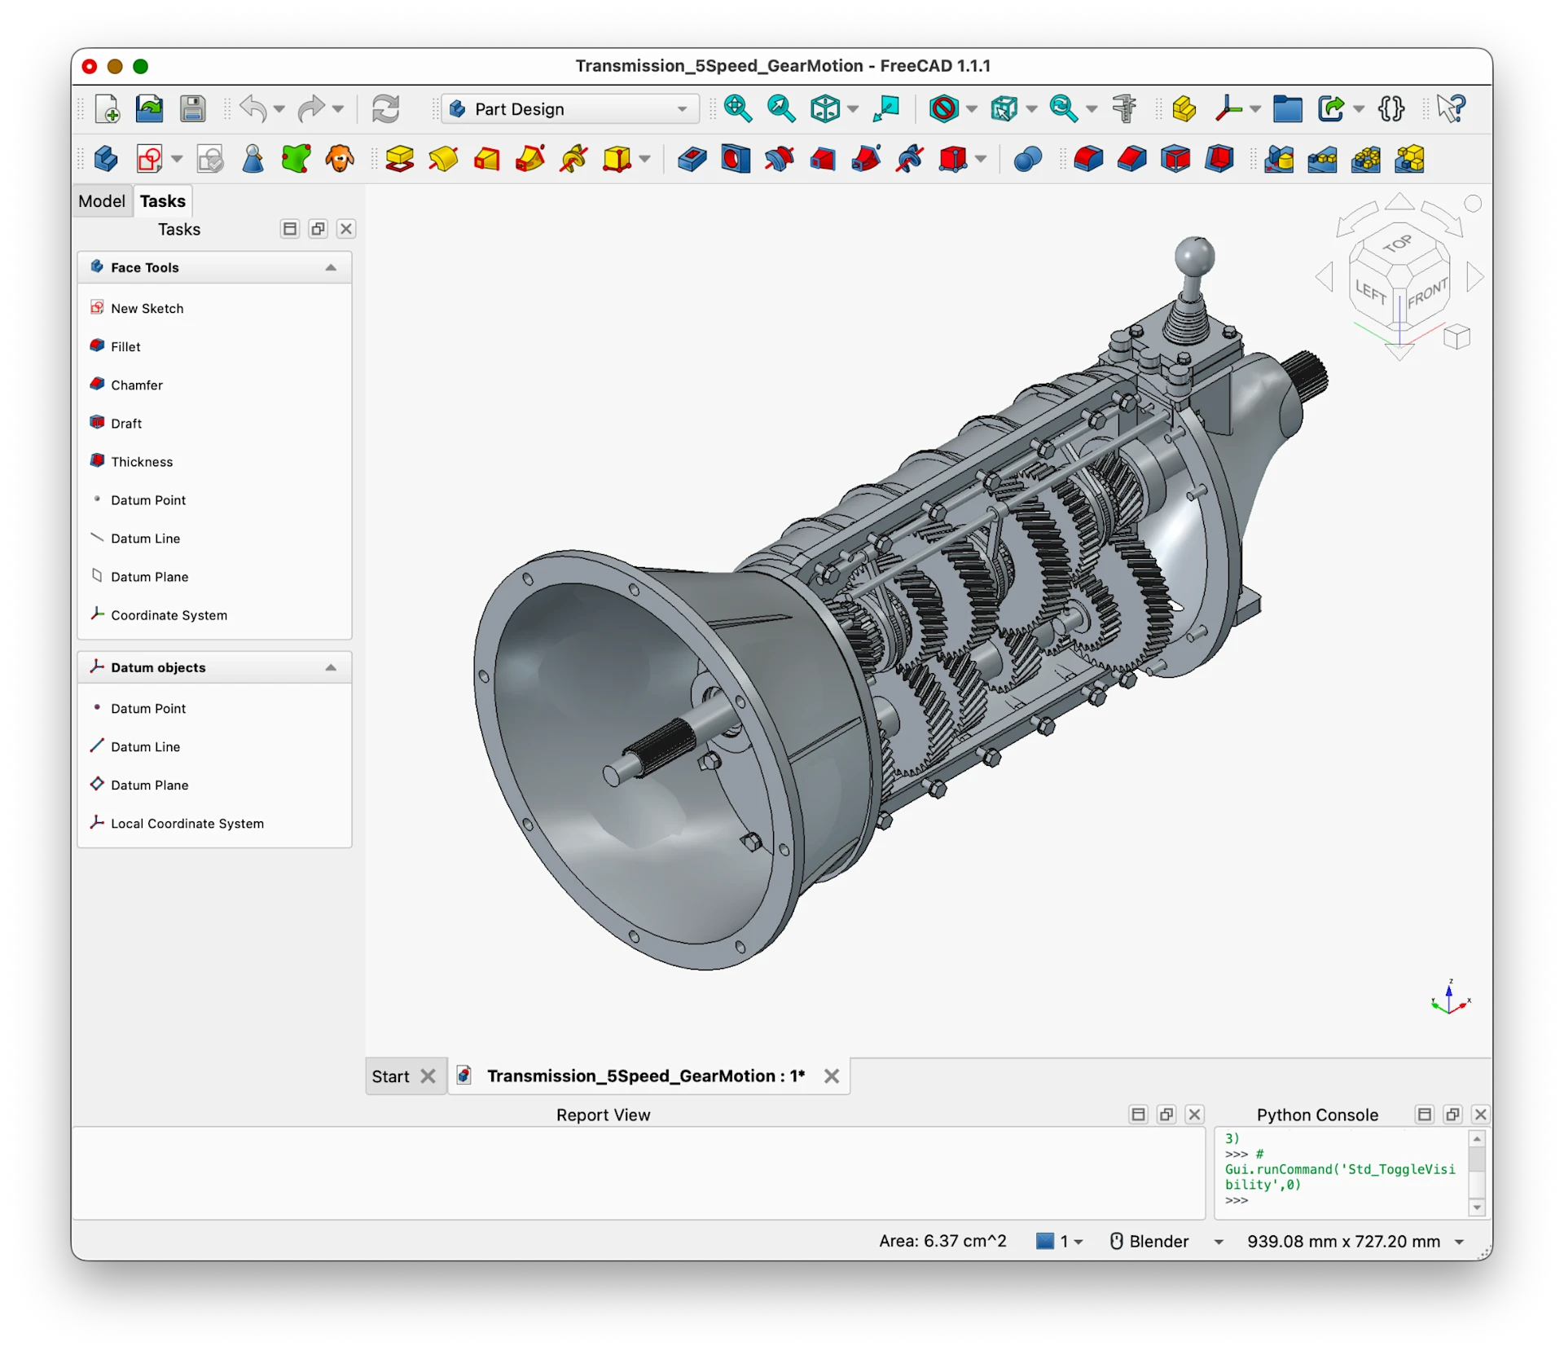
GPT-6: From ideas to creations

Slide 8
Analysis & Strategy The Agentic Shift: Benefits, Risks & Guardrails
PROS
CONS
SOLUTION
The Advantages
Autonomous Action: Minimizes manual effort by handling complex software workflows and routine tasks.
Scale & Efficiency: Enables rapid execution through continuous, multi-agent workflows and 24/7 operation.
The Risks
Loss of Oversight
Unmonitored AI can compound errors and produce incorrect decisions.
High Friction: Requires complex setup and makes real-time outputs difficult to verify.
Active Guardrails
Human in the loop:Keep humans involved through structured validation and approval checkpoints.
Fact Verification: Use trusted external sources and tools to verify important AI outputs before execution.
Key Takeaway: AI can act autonomously – but important decisions need human oversight

Slide 9

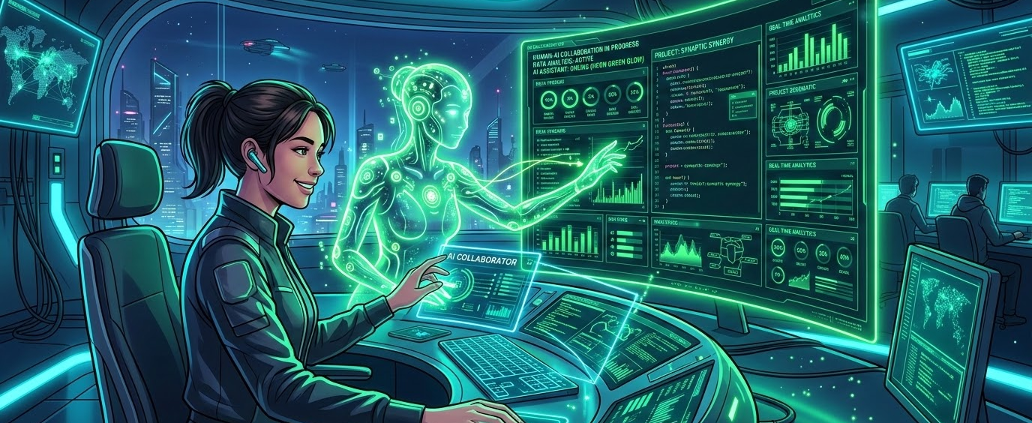
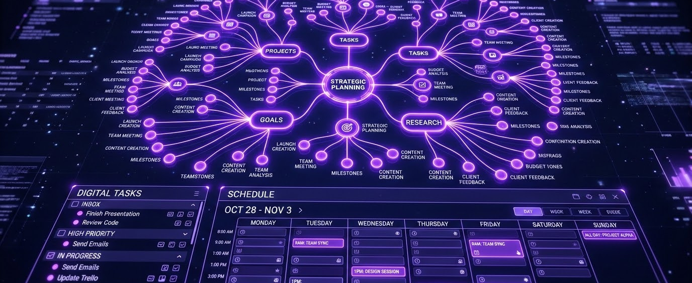

Maximizing AI in Daily Life
01
02
03
Co-Pilot Mindset
Treat AI as an interactive partner rather than a search engine.
Engage in active dialogue, refine prompts iteratively, and ask it to critique your drafts to level up daily productivity.
Critical Thinking
Don’t Outsource your thinking.
Challenge AI's assumptions, compare alternatives, and make the final call.
Question → Monitor → Improve
Fact Verification
Always apply critical oversight to AI outputs.
Use AI to generate structures and blueprints, but rely on trusted sources to verify any factual data or calculations.
Key Takeaway: AI can improve everyday productivity by handling routine and complex tasks, but human judgment remains essential for accuracy and effective decision making.

Slide 10
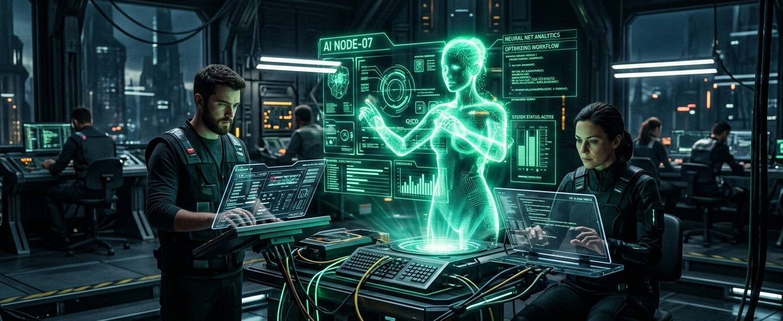
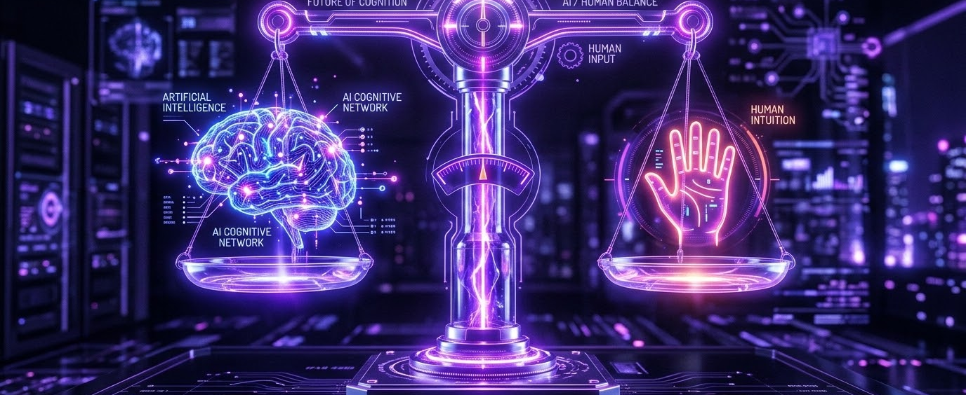

SUMMARY & TAKEAWAYS
Conclusion: What Did We Learn?
01
02
03
The Agentic Shift
Beyond Chatbots
AI is moving from a passive helper into an active coworker capable of executing multi-step workflows autonomously.
Balanced Guardrails
Human + AI
AI provides speed and scale, but human oversight is essential to catch errors and verify important decisions.
THE HUMAN ADVANTAGE
Humans Decide
Multi-agent systems automate complex workflows while trusted verification keeps outputs reliable.
Key Takeaway: The future isn’t AI vs humans , its humans + AI,

Slide 11
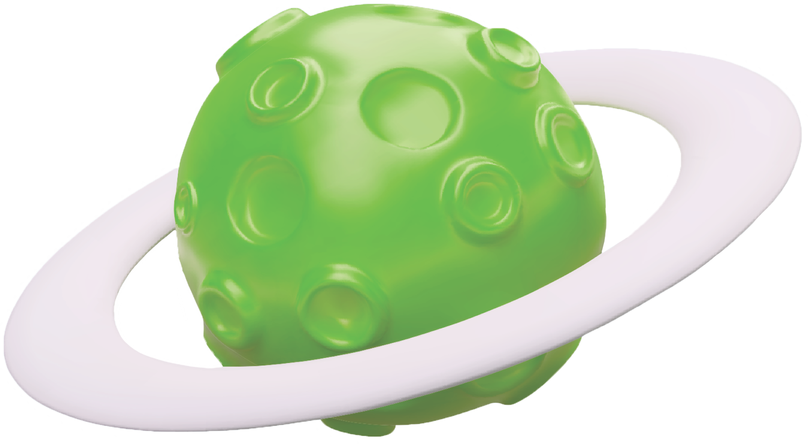
CONTACT & DISCUSSION
Thank You.
UNDER THE GUIDANCE OF
Ms. Aastha Kashyap &
Mr.Sumit Anand
Assistant Professor, Department of CSE
Any Questions?
We would like to sincerely thank our respected judges, faculty members, mentors, and everyone who gave us their valuable time and attention.
Thank you for listening. We’d be happy to answer any questions and discuss the ideas presented today.

